Slide 1

DATA SCIENCE AND MACHINE LEARNING
LIVE SESSION

Slide 2
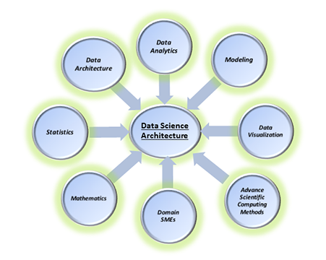
What is Data Science
Data Science is a blend of various tools, algorithms, and machine learning principles with the goal to discover hidden patterns from the raw data.
Data Science is primarily used to make decisions and predictions making use of predictive causal analytics, prescriptive analytics (predictive plus decision science) and machine learning.

Slide 3
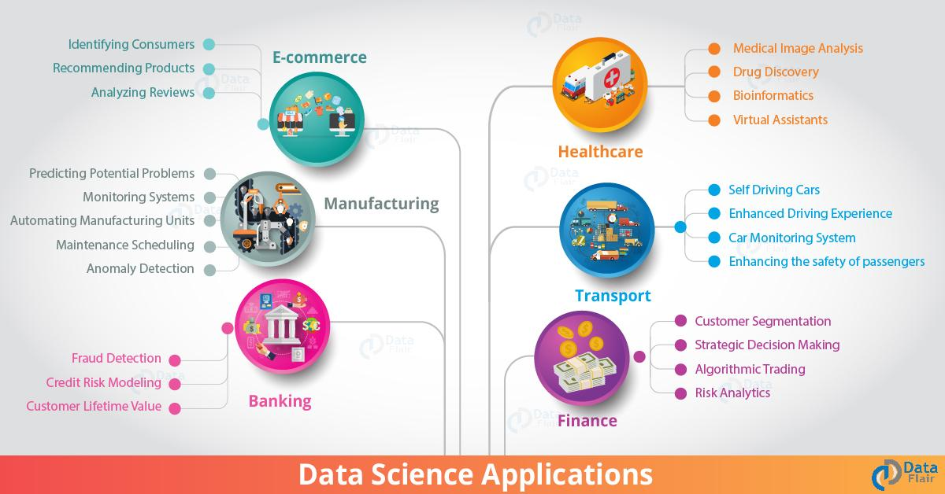
Why Data Science?
Traditionally, the data that we had was mostly structured and small in size, which could be analyzed by using simple BI tools.
Unlike data in the traditional systems which was mostly structured, today most of the data is unstructured or semi-structured.

Slide 4
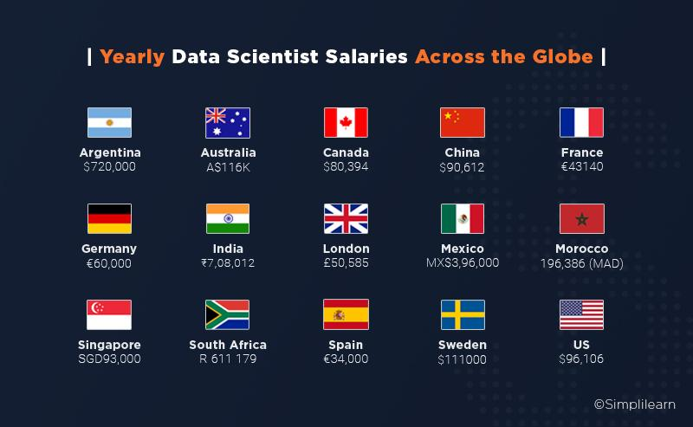
Growth in Data Science Profession
Source: Simplilearn

Slide 5
BOOTCAMP STRUCTURE
DAY 1 - PANDAS AND NUMPY
DAY 6-POLYNOMIAL REGRESSION
DAY 11 - NAIVE BAYES
DAY 2 - MATPLOTLIB AND SEABORN
DAY 7 - LOGISTIC REGRESSION
DAY 12 - KNN
DAY 3 - DATA ANALYSIS / EDA
DAY 8 - DECISION TREE
DAY 13 - SVM
DAY 4 - MACHINE LEARNING
DAY 9 - RANDOM FOREST0
DAY 14- CLUSTERING ALGORITHMS
DAY 5 - LINEAR REGRESSION
DAY 10 - XG BOOST
DAY 15 - DEPLOYING MODELS

Slide 6







PYTHON PACKAGES FOR MACHINE LEARNING

Slide 7
INTRODUCTION TO PANDAS
AND NUMPY

Slide 8
NumPy stands for numerical python.
It is the core library for scientific computation.
Library contains large number of mathematical algebraic functions.
Calculate statistic and answer question about data.
What is NumPy ?

Slide 9
Mutable
We can do indexing and slicing.
Perform element wise operations.
Arithmetic and Vectorized operation.
PROPERTIES OF NUMPY

Slide 10
Both are mutable
Both can be indexed and sliced.
Both are used as collector to store data.
SIMILARITIES BETWEEN NUMPY AND LISTS

Slide 11
DIFFERENCE BETWEEN NUMPY AND LISTS
Inside lists we have elements of multiple data type.
Lists are slow compared to NumPy.
We cannot do element wise operation.
Lists takes up more size
All the elements must be of same datatype.
NumPy arrays are faster than lists.
We can do element wise operations in numpy.
Takes less size as compared to list
LIST
NUMPY

Slide 12
Widely used python library
Provides high performance easy to use structures for data analysis.
Can perform operations like Data Cleaning, Transforming and Analyzing.
Calculate statistic and answer question about data.
What is Pandas ?

Slide 13
Read and write files
Check information and description about our data.
Filter data
Handle missing values and noise.
Do aggregation and summarization.
Merge and concatenate datasets.
WHAT CAN WE DO WITH PANDAS ?

Slide 14
TIME TO CODE
LET’S GET INTRODUCED TO COLAB

